Slide 1

ERP ASSISTANT
A new Dimension to the ERP

Slide 2


ERP Assistant?
Extension of the existing ERP by adding a set of new features
Ability to find free slots for extra class, for professors
Ability to see number of classes that can be missed while respecting the attendance criteria, for students

Slide 3
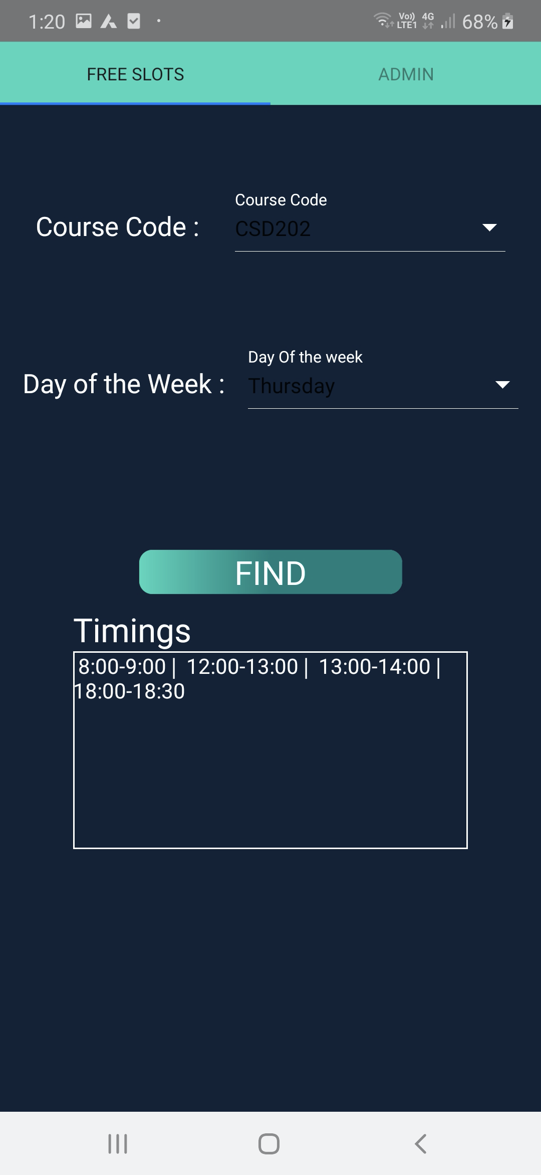
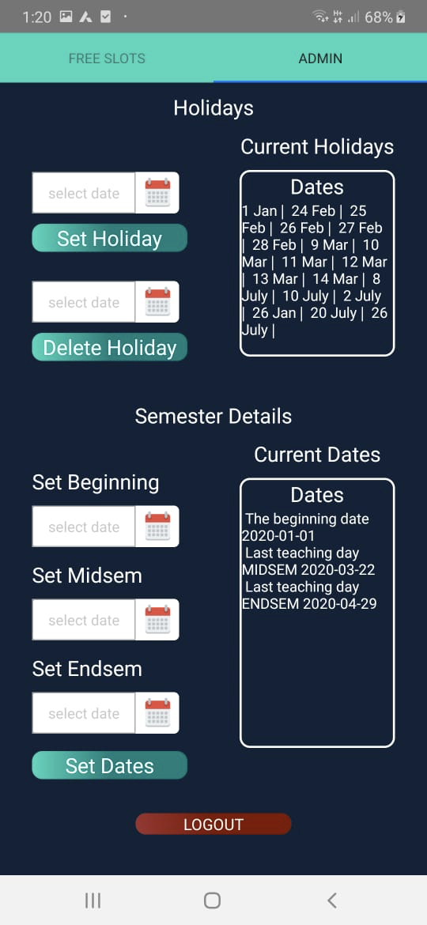
Professors’ Portal
The Free Slots feature of the app bridges the gap between the students and the professor in coordinating to find common free slots in all their timetables in order to reschedule or conduct an extra class.
We have also given Admin access in this portal which controls the calendar details of the semester.

Slide 4
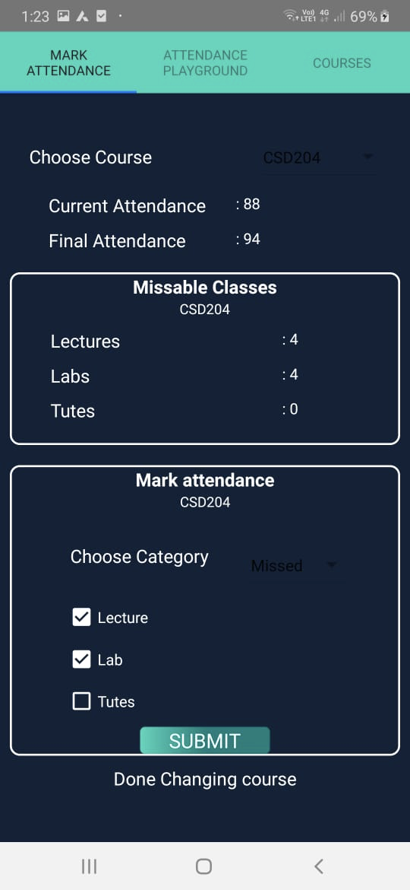
Students’ Portal
Attendance Tracker
This handy feature will allow students to manage their attendance efficiently by removing the hassle of calculating and counting classes in order to meet attendance criteria for each course. It displays how many classes at most can be missed and also takes into consideration criteria like attendance condonement.
In the Mark Attendance tab, students can update the app about their absence during a class , meaning, if they missed, got condoned or there was no class on a particular day.

Slide 5
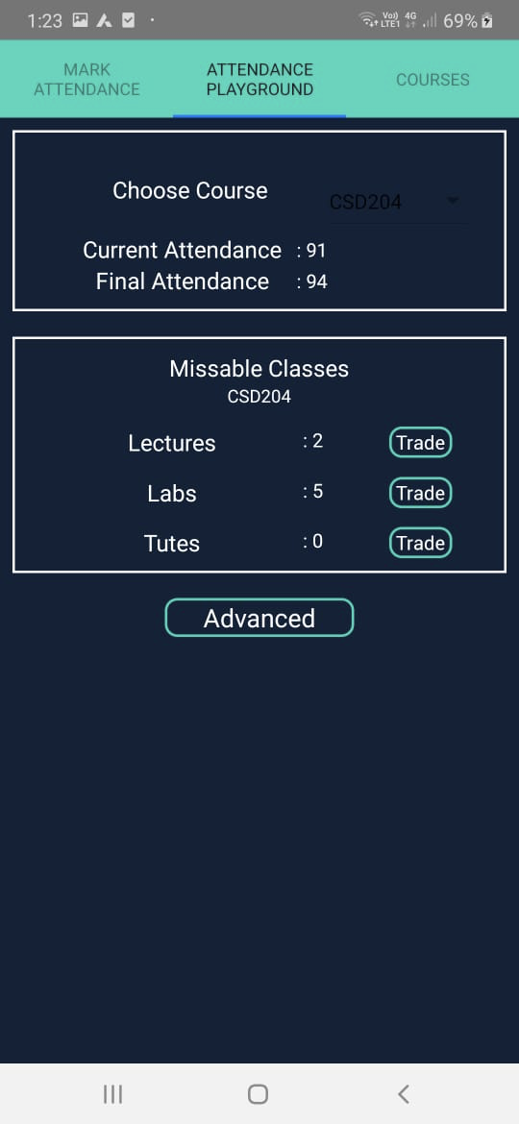
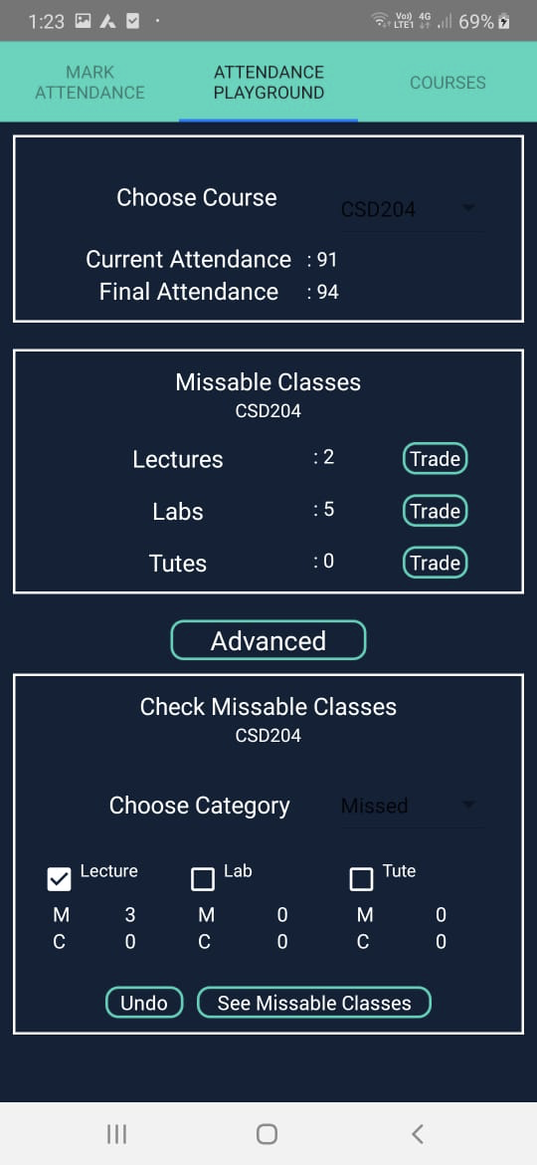
In the Attendance Playground tab, the user would be allowed to play around with their classes with options like trading lectures for a lab or lab for a tute or vice-versa.
Additionally, we’ve added an advanced section where the user can check his/her attendance upon missing or getting a course condoned in the future and avoid putting themselves in a position of going below the minimum attendance requirement.

Slide 6
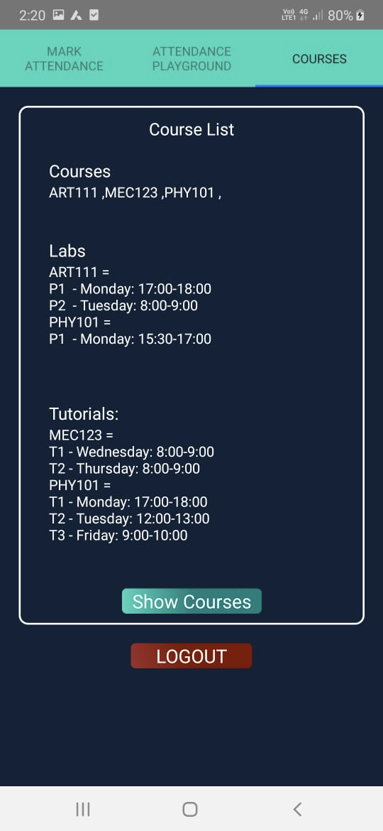
Course List Filter
In this feature of the app, we aim to simplify the process of enrolling in different courses at the start of every semester or half semester.
It displays a filtered list of all the different courses available that semester that fit into the student’s timetable perfectly along with their preferred lab and tutorial slots (if any). Thus, it provides optimum timetable management for students to see what courses they can enroll in without having to worry about time clashes and such.

